Slide 1


Presentation Flex Box Adrien Houen

Slide 3
Introduction to Flexbox Layout
Align
Distribute space
To give the container the ability to alter its items’ to best fill the available space
the flexbox layout is direction-agnostic

Slide 4
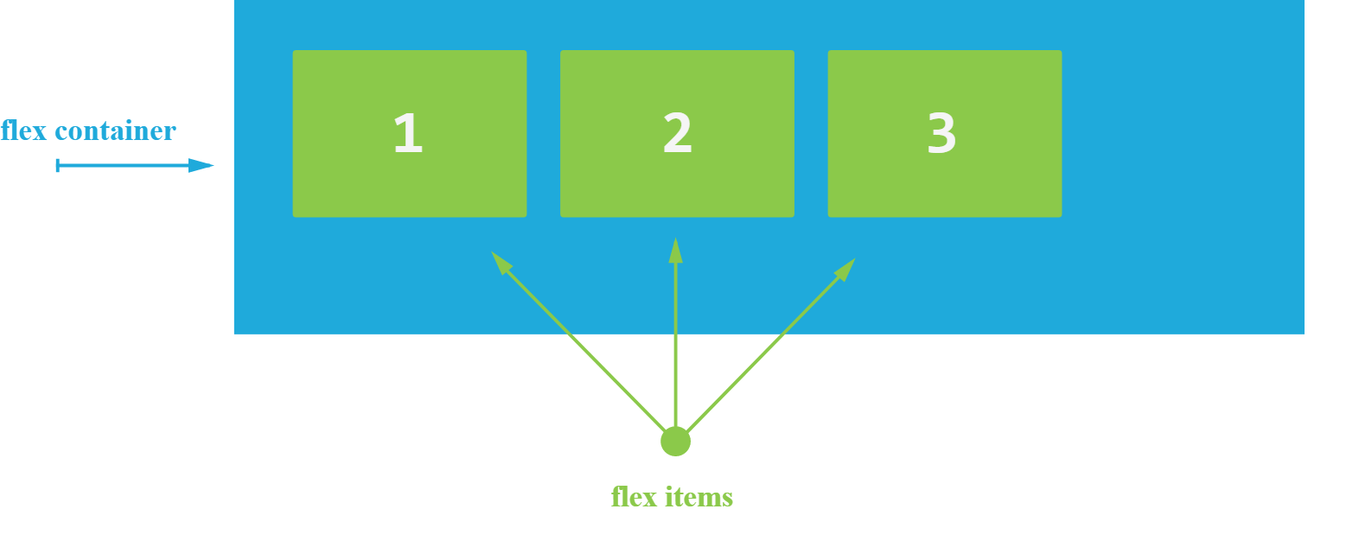
Basic

Slide 5
Flexbox properties
Properties for the Parent
(flex container)
Properties for the Children
(flex items)
Display
Flex-direction
Flex-wrap
Flex-flow
Justify-content
Align-items
Align-content
Order
Flex-grow
Flex-shrink
Flex-basis
Flex
Align-self

Slide 6
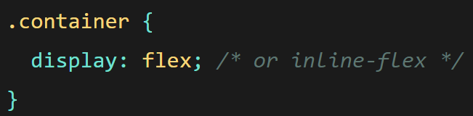
display
Transform HTML element into Flex container

Slide 7
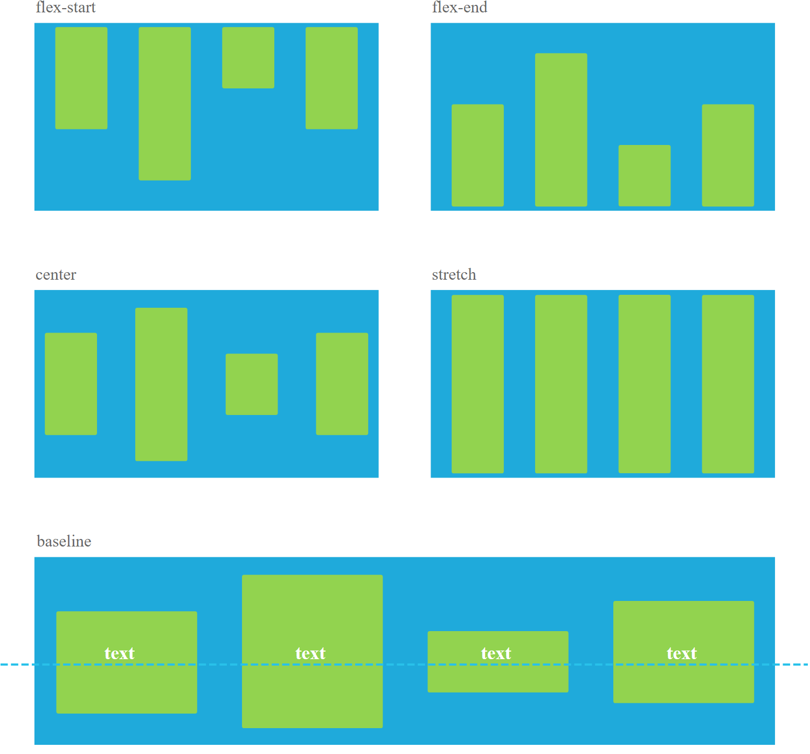
align-items
Stretch (default)
Flex-start / start / self-start
Flex-end / end / self-end
Center
Baseline

Slide 8
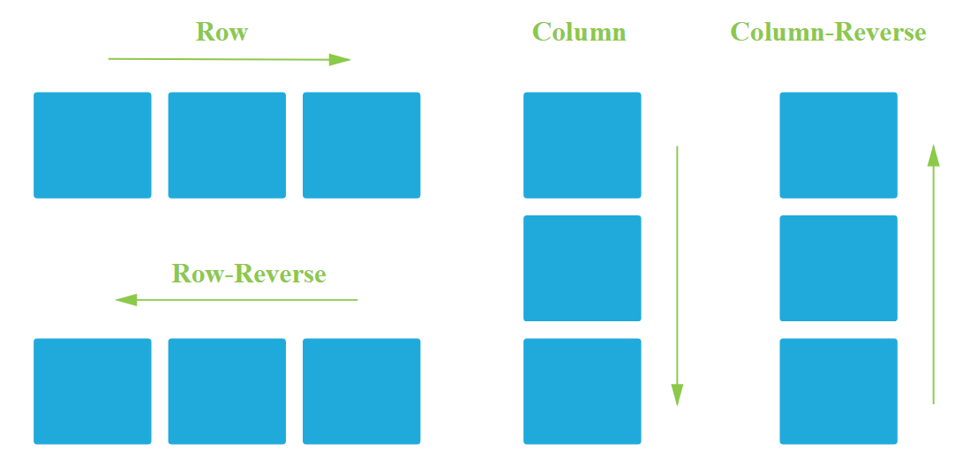
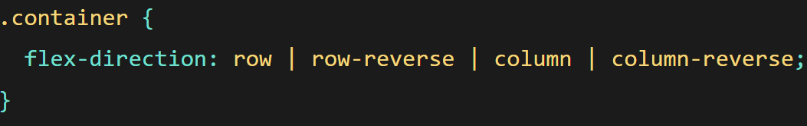
flex-direction
Row (default)
Row-reverse
Column
Column-reverse

Slide 9
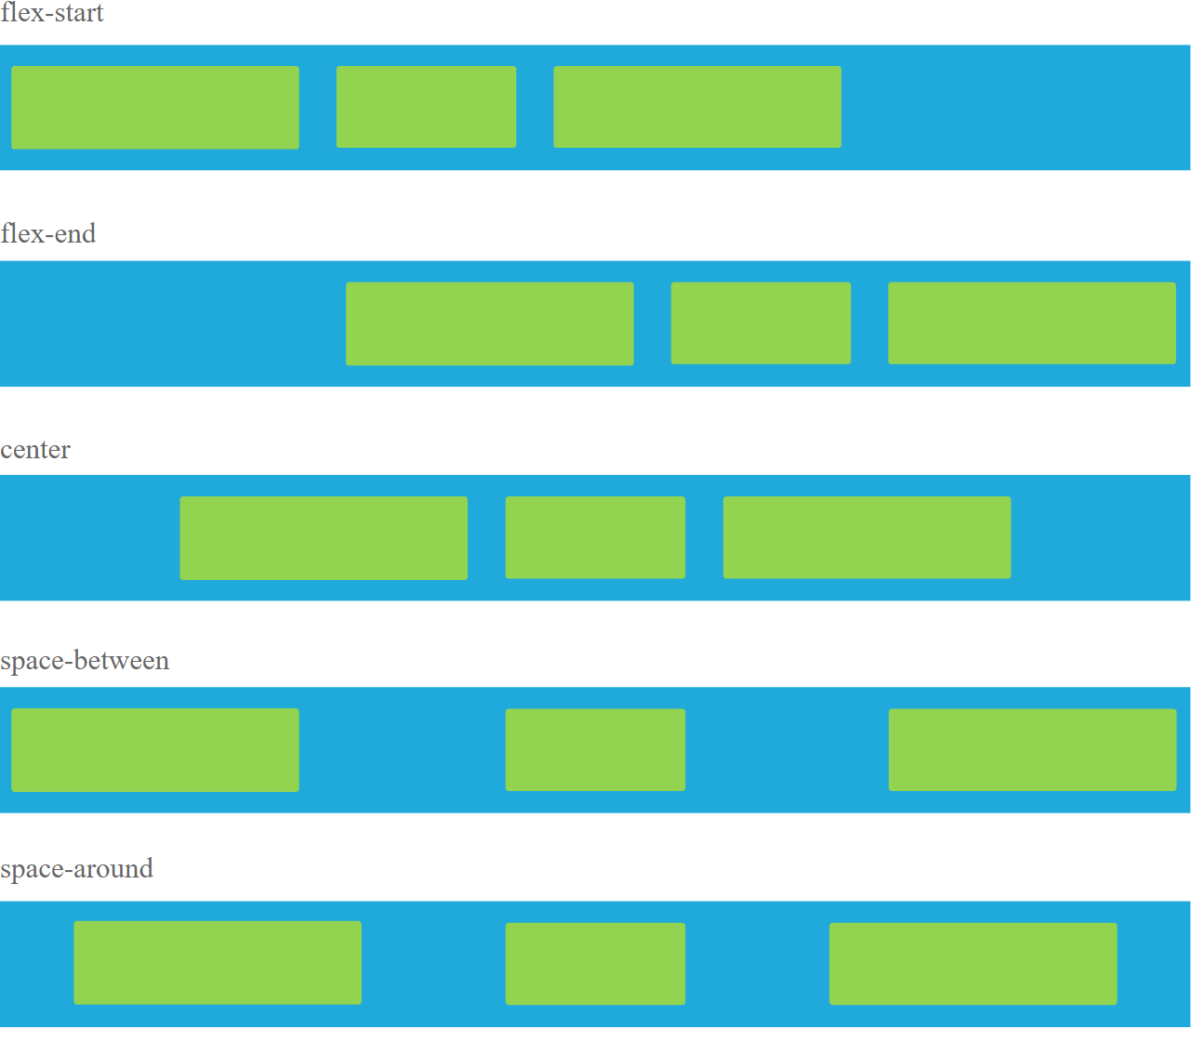
Justify-content
Flex-start (default)
Flex-end
Center
Space-between
Space-around
Space-evenly

Slide 10
order
a voir

Slide 11
Flex-grow
a voir

Slide 12


Let’s pratice ☺

